Slide 1
Deep Convolutional Encoder-Decoder Architecture for Pixel-wise Image Segmentation
Yash Patel, Chandni Patel

Slide 2
PROBLEM
Using semantic pixel-wise segmentation create deep fully convolutional neural network architecture.
The main purpose will be to understand spatial relationship between classes like road, sidewalk from road scenes through modelling appearances (road, building) and shapes (car, pedestrians).
retaining the boundary information from the extracted image representation.

Slide 3
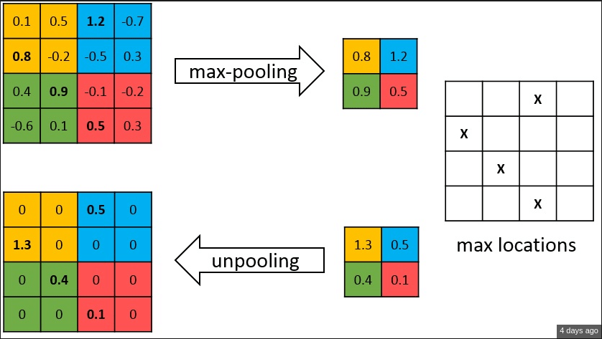
approach
The main component of SegNet is the decoder network that consists of a hierarchy of decoders.
For each decoder we have corresponding encoder.
To perform non-linear upsampling of the input feature maps, the decoders use the max-pooling indices received from the corresponding encoder.

Slide 4
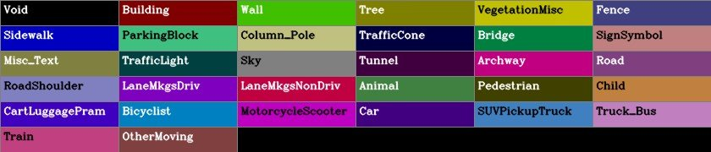
Dataset
Cambridge-driving Labeled Video Database (CamVid)
369 training, 100 validation, and 232 testing
RGB images at 960 x 720 resolution.
We resized the images to 128 x 128 resolution.
Then randomly 50% images are augmented for trained
horizontal flip, vertical flip, contrast, and brightness randomly to input images
flip corresponding output images.

Slide 5
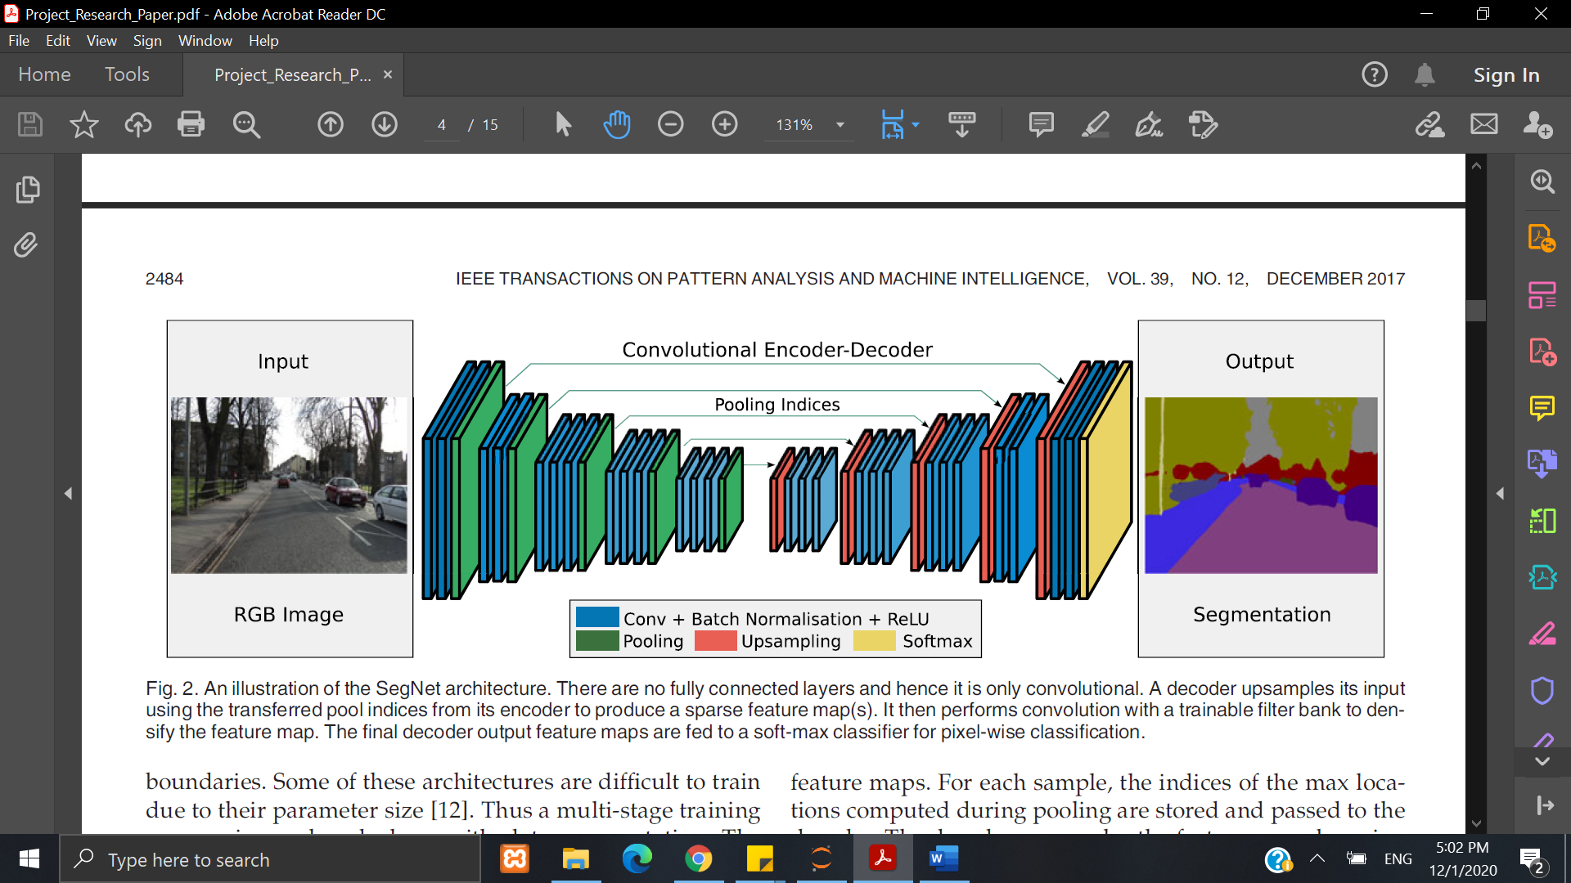
ARCHITECTURE

Slide 6
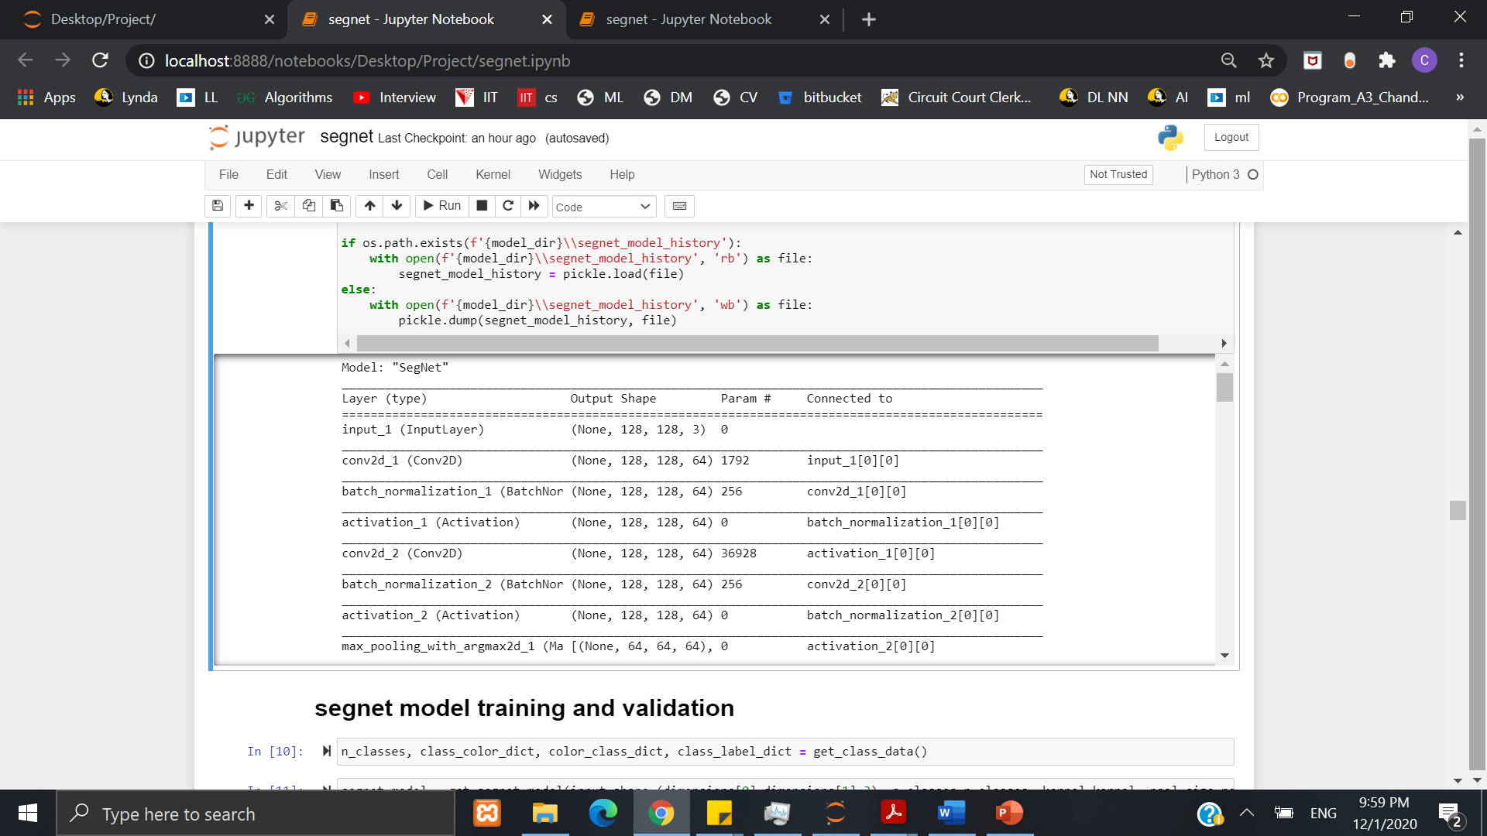
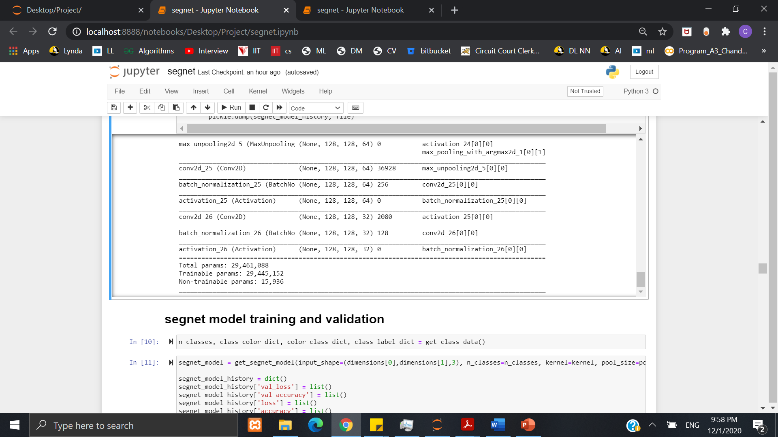
…

Slide 7
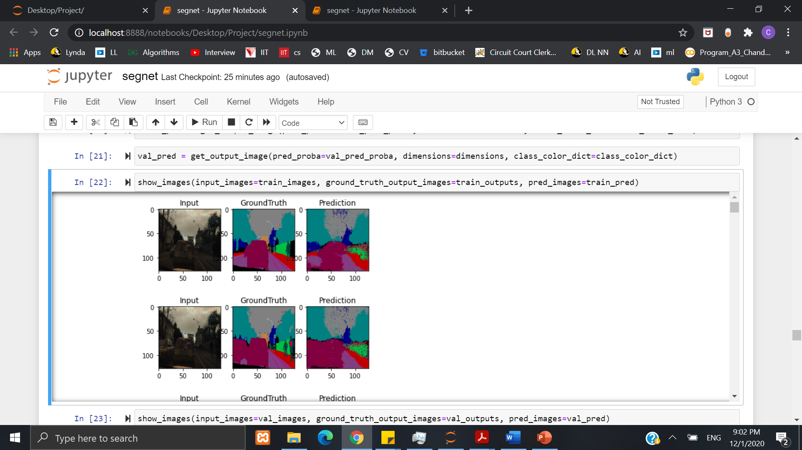
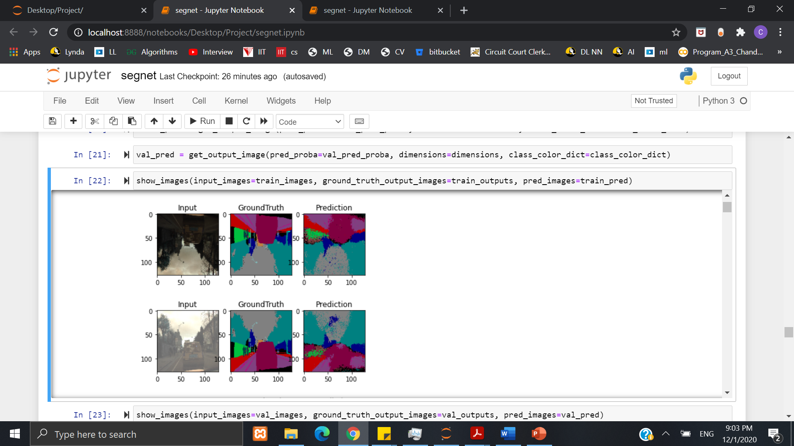
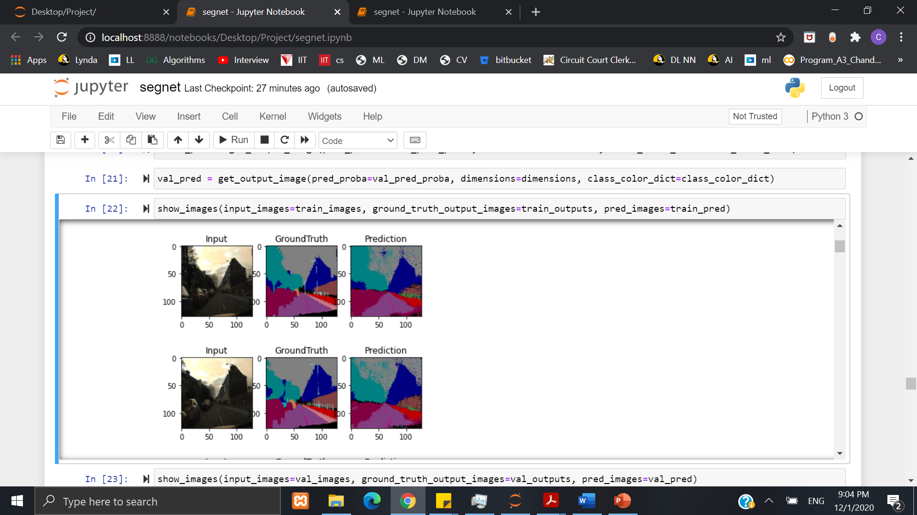
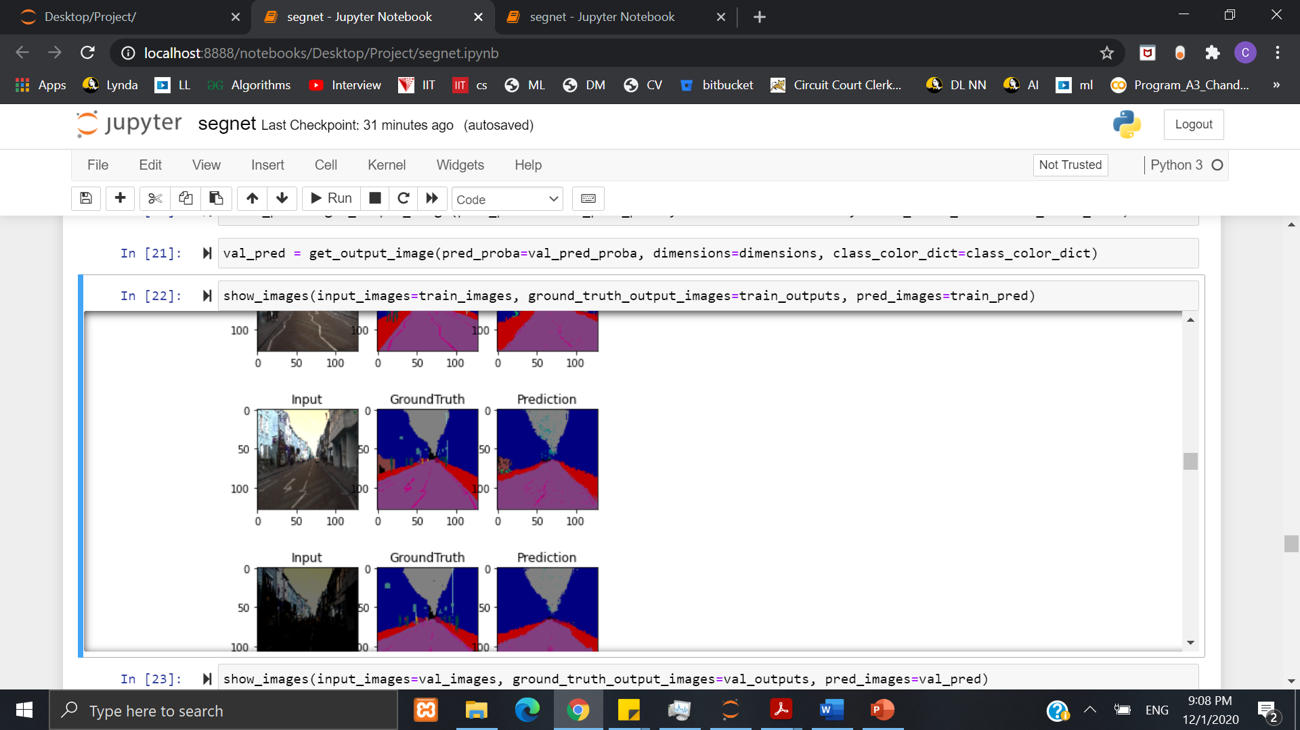
RESULTs

Slide 8



EVALUATION

Slide 9
CONCLUSION
Advantage of this model when compared to others:
smaller size - 112 MB
fewer parameters - 29,461,088
increased training speed
Issues:
Processing power
Memory
time

Slide 10
Thank you
Any question?

